Slide 1
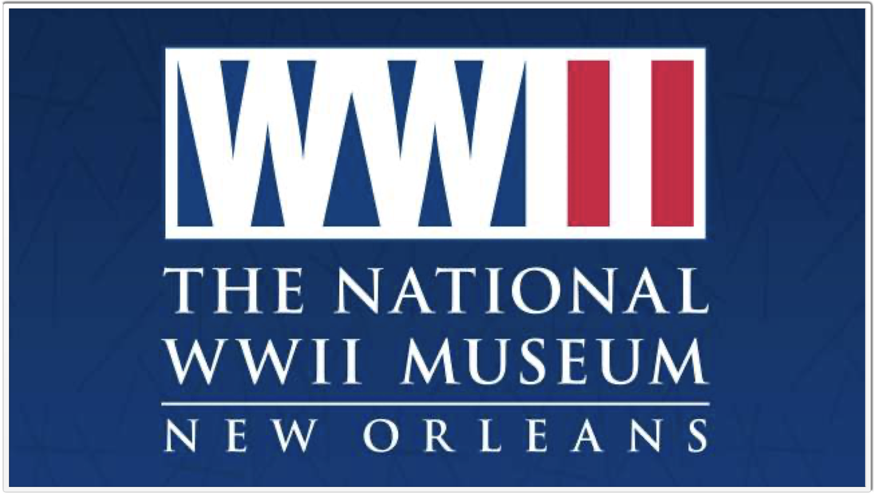
Oral Histories, Memory, and the teaching of WWii
Dr. Kristen D. Burton, The National WWII Museum

Slide 2
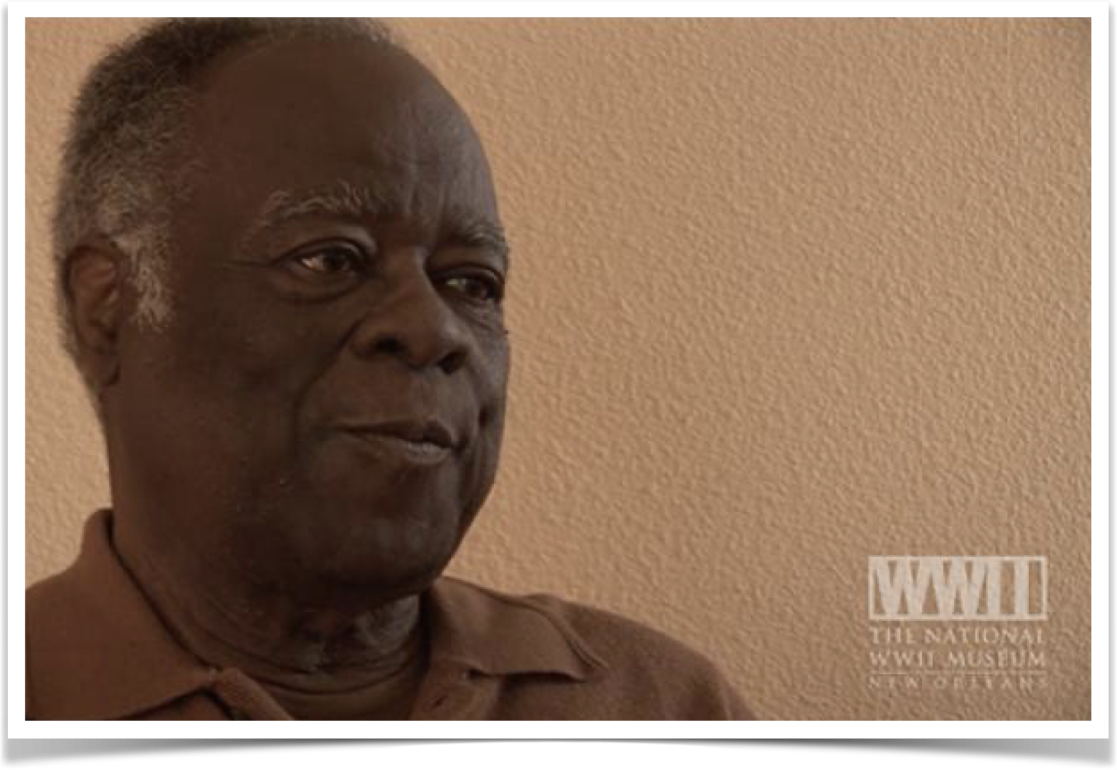
Oral Histories at The National WWII Museum
The Museum houses over 250,000 artifacts.
Over 9,000 personal accounts, including ~7,000 oral histories.
  Began with a collection of 150.

Slide 3
Teaching with Oral Histories
A different kind of primary source; bringing history to life with an individual voice.
  Helps to humanize the past. Reminds students that people are at the heart of all historical events. Oral histories allow students to see these events through an individual’s perspective.
Opens discussions about how perspectives can shape understanding of historical narratives.
Reinforces the importance of critical thinking. Dealing with memories vs. documented sources.

Slide 4
"History has to be rewritten in every generation, because although the past does not change the present does; each generation asks new questions of the past, and finds new areas of sympathy as it re-lives different aspects of the experiences of its predecessors."
–Christopher Hill

Slide 5
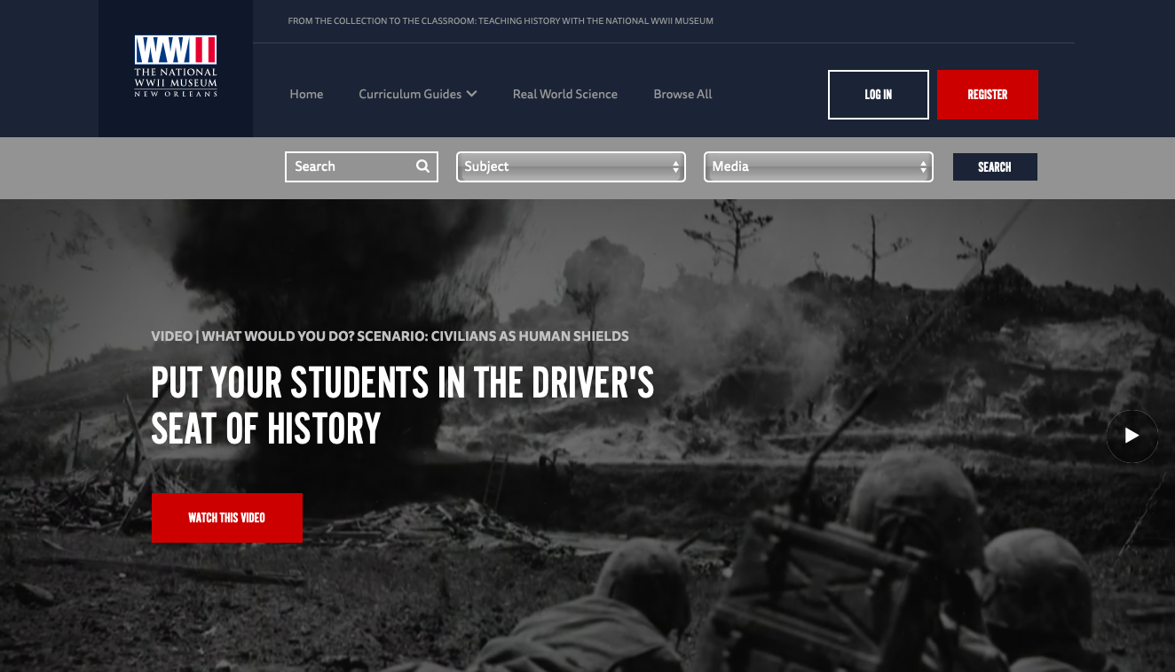

Slide 6
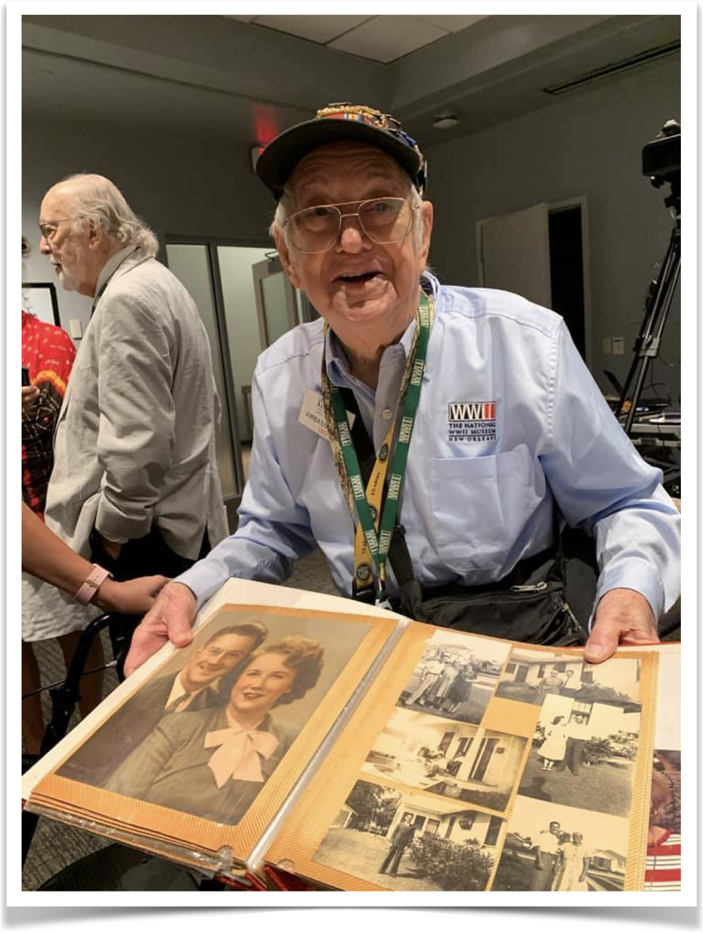
History & Memory
Gives students first-person perspective to life during the largest and most devastating conflict in world history.
Can offer supplementary material to current lectures, or can serve as separate primary sources for student analysis.
Offers students the opportunity to assess whether an oral history supports or changes broader historical narratives.

