Slide 1
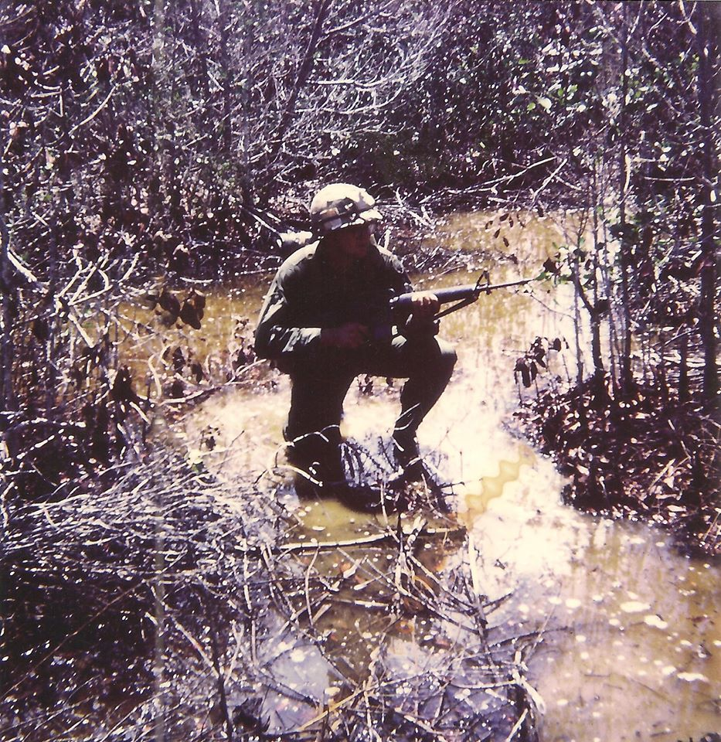
Voices from the Vietnam War

Slide 4
1st Platoon Troopers

Slide 5
Chaplain Bernard Windmiller

Slide 6
Duffy and Ida Black

Slide 7
John Young one week before the battle of 19 June

Slide 8
Jim Rademacher (center)

Slide 9
Elijah Taylor

Slide 10
Bill Geier and his mother Bernice

Slide 11
Charlie Nelson

Slide 12
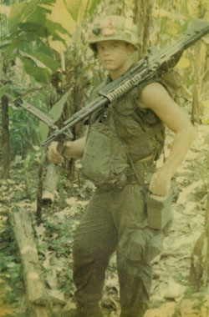
Ernie Hartman

Slide 13
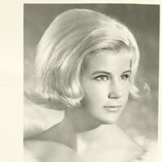
Jacque Peterson

